Slide 1

UNIT-V
Introduction to Seaborn
Seaborn
UNIT-I
Department of CSE, School of Engineering, Malla Reddy University.
Notes:
You can safely remove this slide. This slide design was provided by SlideModel.com – You can download more templates, shapes and elements for PowerPoint from http://slidemodel.com

Slide 2

1. Introduction to Seaborn
2. Using Seaborn with Matplotlib
3. Customizing Seaborn Plots
  Changing Figure Aesthetic
  Removal of Spines
  Changing the figure Size
  Scaling the plots
  Setting the Style Temporarily
4. Color Palette
  Diverging Color Palette
  Sequential Color Palette
  Setting the default Color Palette
5. Multiple plots with Seaborn
  Using Matplotlib
  Using Seaborn
01
08
Middle Level
Language
Memory
Management
Structured
Language
Speed
03
07
Rich Library
04
Seaborn
UNIT-I
Department of CSE, School of Engineering, Malla Reddy University.

Slide 3
Q1: Introduction to Seaborn:
Seaborn is a python data visualization library . It is built on top of Matplotlib and integrates with pandas Data Structures.
It provides beautiful default styles and color palettes to make statistical plots more attractive.
First of all, let us install Seaborn by using following pip command.
The main aims of seaborn is to make visualization is the central part of exploring and understanding data.
It provides dataset-oriented APIs, so that we can switch between different visual representations for same variables for better understanding of dataset.
01
08
Middle Level
Language
02
Memory
Management
Structured
Language
Speed
03
pip install seaborn
07
Rich Library
04
Pointers
Extensible
Recursion
05
Seaborn
UNIT-I
Department of CSE, School of Engineering, Malla Reddy University.

Slide 4
Seaborn has the following dependencies
  Python
  numpy
  scipy
  pandas
  matplotlib
  Note: Before using seaborn, first Install all dependencies of seaborn
01
08
Middle Level
Language
02
Memory
Management
Structured
Language
Speed
03
07
Rich Library
04
Seaborn
UNIT-I
Department of CSE, School of Engineering, Malla Reddy University.

Slide 5
Some of the Syntaxes of seaborn :
# importing seaborn library
import seaborn as sns
# loading predefined dataset (iris) by using following syntax
data = sns.load_dataset("iris")
# loading user defined dataset using seaborn dependency library ( pandas)
data= pd.read_csv(r"C:\Users\RamaraoT\Desktop\new\student.csv")
# draw lineplot
sns.lineplot(x,y)
01
08
Middle Level
Language
02
Memory
Management
Structured
Language
Speed
03
07
Rich Library
04
Pointers
Extensible
Recursion
05
Seaborn
UNIT-I
Department of CSE, School of Engineering, Malla Reddy University.

Slide 6
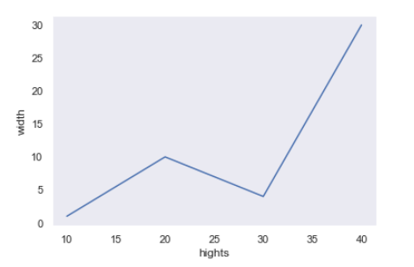
Example:1 To draw simple line plot using seaborn with following dataset.
# importing packages
import seaborn as sns
import pandas as pd
import matplotlib.pyplot as plt
# Dataset
x=[10,20,30,40]
y=[1,10,4,30]
# sns.xlabel("heights") # error, seaborn not Support
plt.xlabel(“width")
plt.ylabel(“height")
# draw lineplot
sns.lineplot(x,y)
Output:
01
08
Middle Level
Language
02
Memory
Management
Structured
Language
Speed
03
07
Rich Library
04
Pointers
Extensible
Recursion
05
Seaborn
UNIT-I
Department of CSE, School of Engineering, Malla Reddy University.

Slide 7
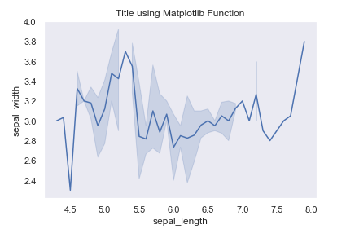
Using Seaborn with Matplotlib:
Using both Matplotlib and Seaborn together is a very simple process. We just have to invoke the Seaborn Plotting function as normal, and then we can use Matplotlib customization functions (examples: title,xlabel,ylabel,xlim,ylim and show) .
01
08
Middle Level
Language
02
# importing packages
import seaborn as sns
import matplotlib.pyplot as plt
# loading dataset
data = sns.load_dataset("iris")
# setting the title using Matplotlib
plt.title('Title using Matplotlib Function‘)
# draw lineplot
sns.lineplot(x="sepal_length", y="sepal_width", data=data)
Memory
Management
Structured
Language
Speed
03
07
Rich Library
04
Pointers
Extensible
Recursion
05
Seaborn
UNIT-I
Department of CSE, School of Engineering, Malla Reddy University.

Slide 8
Seaborn Plots:
Import seaborn as sns https://seaborn.pydata.org/api.html
1. Line plot : sns.lineplot(x,y) https://seaborn.pydata.org/generated/seaborn.lineplot.html#seaborn.lineplot
2. Bar plot : sns. barplot(x,y) https://seaborn.pydata.org/generated/seaborn.barplot.html#seaborn.barplot
3. Hist plot : sns.histplot(x,y) https://seaborn.pydata.org/generated/seaborn.histplot.html
4. Scatter plot: sns. Scatterplot(x,y) https://seaborn.pydata.org/generated/seaborn.scatterplot.html
5. Boxplot: sns. boxplot(x,y) https://seaborn.pydata.org/generated/seaborn.boxplot.html#seaborn.boxplot
6. Strip plot (jitter plot) sns. Stripplot(x,y) https://seaborn.pydata.org/generated/seaborn.stripplot.html#seaborn.stripplot
01
08
Middle Level
Language
02
Memory
Management
Structured
Language
Speed
03
07
Rich Library
04
Pointers
Extensible
Recursion
05
Seaborn
UNIT-I
Department of CSE, School of Engineering, Malla Reddy University.

Slide 9
Different categories of plots in Seaborn:
  Relational plots:
  This plot is used to understand the relation between two variables.
  Categorical plots:
  This plot deals with categorical variables and how they can be visualized.
  Distribution plots:
  This plot is used for examining univariate and bivariate distributions.
  Regression plots:
  The regression plots in seaborn are primarily intended to add a visual guide that helps to emphasize patterns in a dataset during exploratory data analyses.
  Matrix plots: A matrix plot is an array of scatter plots.
  Multi-plot grids: It is an useful approach is to draw multiple instances of the same plot on different subsets of the dataset.
01
08
Middle Level
Language
02
Memory
Management
Structured
Language
Speed
03
07
Rich Library
04
Pointers
Extensible
Recursion
05
Seaborn
UNIT-I
Department of CSE, School of Engineering, Malla Reddy University.

Slide 10
Relational plots:
  In seaborn 3 types of Relational plots are available.
  Relplot
  Scatterplot
  lineplot
Relplot: Figure-level interface for drawing relational plots onto a FacetGrid. provides access to several different axes-level functions that show the relationship between two variables with semantic mappings of subsets.
The kind parameter selects the underlying axes-level function to use:
scatterplot() (with kind="scatter"; the default)
lineplot() (with kind="line")
The relationship between x and y can be shown for different subsets of the data using the hue, size, and style parameters. These parameters control what visual semantics are used to identify the different subsets.
01
08
Middle Level
Language
02
Memory
Management
Structured
Language
Speed
03
07
Rich Library
04
Pointers
Extensible
Recursion
05
Seaborn
UNIT-I
Department of CSE, School of Engineering, Malla Reddy University.

Slide 11
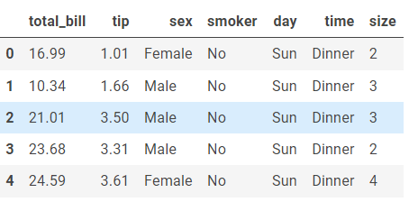
Dataset Description:
Tips dataset is a data frame with 244 rows and 7 variables which represents some tipping data where one waiter recorded information about each tip he received over a period of a few months working in one restaurant. In all the waiter recorded 244 tips.
tips = sns.load_dataset("tips")
tips.head()
01
08
Middle Level
Language
02
Memory
Management
Structured
Language
Speed
03
07
Rich Library
04
Pointers
Extensible
Recursion
05
Seaborn
UNIT-I
Department of CSE, School of Engineering, Malla Reddy University.

Slide 12
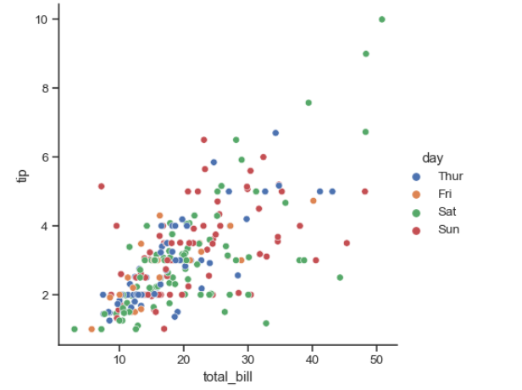
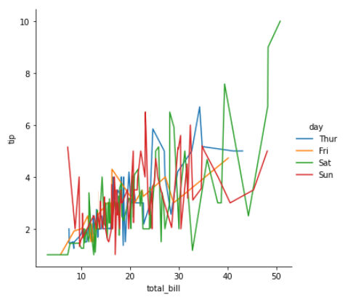
Relational plots:
Relplot:
Relplot returns scatterplot() and lineplot(), which are used when kind="scatter" or kind="line", respectively.
Example 1: sns.relplot(data=tips, x="total_bill", y="tip", hue="day") #bydefault scotterplot
Example 2: sns.relplot(data=tips, x="total_bill", y="tip", hue="day“, kind="line"))
01
08
Middle Level
Language
02
Memory
Management
Structured
Language
Speed
03
07
Rich Library
04
Pointers
Extensible
Recursion
05
Seaborn
UNIT-I
Department of CSE, School of Engineering, Malla Reddy University.

Slide 13
Customizing Seaborn Plots:
Seaborn comes with some customized themes and a high-level interface for customizing the looks of the graphs. we can customize the graph according to our own needs. So let’s see the following styling of plots in detail.
  Changing Figure Aesthetic
  Removal of Spines
  Changing the figure Size
  Scaling the plots
  Setting the Style Temporarily
01
08
Middle Level
Language
02
Memory
Management
Structured
Language
Speed
03
07
Rich Library
04
Pointers
Extensible
Recursion
05
Seaborn
UNIT-I
Department of CSE, School of Engineering, Malla Reddy University.

Slide 14
  1. Changing Figure Aesthetic :
set_style() method is used to set the aesthetic of the plot. It means it affects things like the color of the axes, whether the grid is active or not. There are five themes available in Seaborn.
  darkgrid
  whitegrid
  dark
  white
  ticks
Syntax:
01
08
Middle Level
Language
02
Memory
Management
Structured
Language
Speed
03
07
Rich Library
04
Pointers
set_style(‘style_name’)
Extensible
Recursion
05
Seaborn
UNIT-I
Department of CSE, School of Engineering, Malla Reddy University.

Slide 15
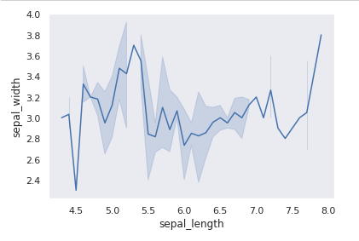
Example: Using the dark theme :
# importing packages
import seaborn as sns
import matplotlib.pyplot as plt
# loading dataset
data = sns.load_dataset("iris")
# draw lineplot
sns.lineplot(x="sepal_length", y="sepal_width", data=data)
# changing the theme to dark
sns.set_style("dark")
plt.show()
01
08
Middle Level
Language
02
Memory
Management
Structured
Language
Speed
03
07
Rich Library
04
Pointers
Extensible
Recursion
05
Seaborn
UNIT-I
Department of CSE, School of Engineering, Malla Reddy University.

Slide 16
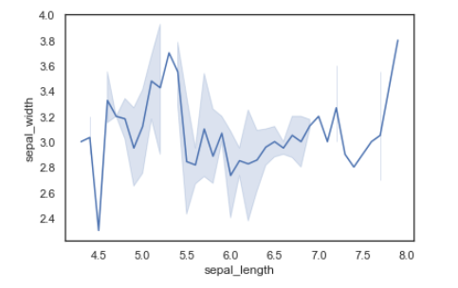
Example: Using the white theme :
# importing packages
import seaborn as sns
import matplotlib.pyplot as plt
# loading dataset
data = sns.load_dataset("iris")
# draw lineplot
sns.lineplot(x="sepal_length", y="sepal_width", data=data)
# changing the theme to dark
sns.set_style(“white")
plt.show()
01
08
Middle Level
Language
02
Memory
Management
Structured
Language
Speed
03
07
Rich Library
04
Pointers
Extensible
Recursion
05
Seaborn
UNIT-I
Department of CSE, School of Engineering, Malla Reddy University.

Slide 17
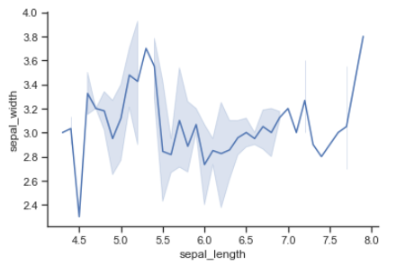
  2. Removal of Spines :
Spines are the lines noting the data boundaries and connecting the axis (x-axies and y-axies) tick marks. It can be removed using the despine() method.[ex: despine(left=True) or despine(bottom=True)
01
08
Middle Level
Language
02
# importing packages
import seaborn as sns
import matplotlib.pyplot as plt
# loading dataset
data = sns.load_dataset("iris")
# draw lineplot
sns.lineplot(x="sepal_length", y="sepal_width", data=data)
# Removing the spines
sns.despine()
plt.show()
Memory
Management
Structured
Language
Speed
03
07
Rich Library
04
Pointers
Extensible
Recursion
05
Seaborn
UNIT-I
Department of CSE, School of Engineering, Malla Reddy University.

Slide 18
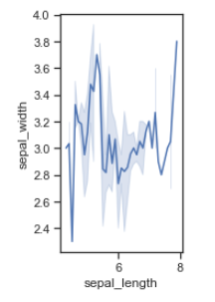
  3. Changing the figure Size:
The figure size can be changed using the figure() method of Matplotlib. figure() method creates a new figure of the specified size passed in the figsize parameter.
01
08
Middle Level
Language
02
# importing packages
import seaborn as sns
import matplotlib.pyplot as plt
# loading dataset
data = sns.load_dataset("iris")
# changing the figure size
plt.figure(figsize = (2, 4))
# draw lineplot
sns.lineplot(x="sepal_length", y="sepal_width", data=data)
Memory
Management
Structured
Language
Speed
03
07
Rich Library
04
Pointers
Extensible
Recursion
05
Seaborn
UNIT-I
Department of CSE, School of Engineering, Malla Reddy University.

Slide 19
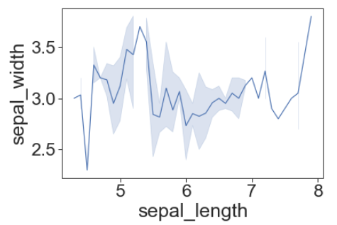
  4. Scaling the plots :
It can be done using the set_context() method. It allows us to override default parameters. This affects things like the size of the labels, lines, and other elements of the plot, but not the overall style. The base context is “notebook”, and the other contexts are “paper”, “talk”, and “poster”. font_scale sets the font size.
https://seaborn.pydata.org/generated/seaborn.set_context.html#seaborn.set_context
01
08
Middle Level
Language
02
Memory
Management
Structured
Language
# importing packages
import seaborn as sns
import matplotlib.pyplot as plt
# loading dataset
data = sns.load_dataset("iris")
# Setting the scale of the plot
#sns.set_context("paper")
sns.set_context("paper",font_scale=2.6)
sns.lineplot(x="sepal_length", y="sepal_width", data=data)
Speed
03
07
Rich Library
04
Pointers
Extensible
Recursion
05
Seaborn
UNIT-I
Department of CSE, School of Engineering, Malla Reddy University.

Slide 20
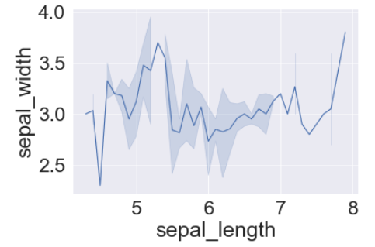
  5.Setting the Style Temporarily:
axes_style() method is used to set the style temporarily. It is used along with the with statement.
# importing packages
import seaborn as sns
import matplotlib.pyplot as plt
# loading dataset
data = sns.load_dataset("iris")
# draw lineplot
sns.lineplot(x="sepal_length", y="sepal_width", data=data)
# Setting the style temporarily
with sns.axes_style('darkgrid'):
sns.lineplot(x="sepal_length", y="sepal_width", data=data)
01
08
Middle Level
Language
02
Memory
Management
Structured
Language
Speed
03
07
Rich Library
04
Pointers
Extensible
Recursion
05
Seaborn
UNIT-I
Department of CSE, School of Engineering, Malla Reddy University.

Slide 21

Color Palette:
Colormaps are used to visualize plots effectively and easily. color_palette() method is used to give colors to the plot. Another function palplot() is used to plots the color palette as a horizontal array.
01
08
Middle Level
Language
02
# importing packages
import seaborn as sns
import matplotlib.pyplot as plt
# current colot palette
palette = sns.color_palette()
# plots the color palette as a horizontal array
sns.palplot(palette)
plt.show()
Under the Color Palette Question you need to explain the following Palettes
Diverging Color Palette
Sequential Color Palette
Setting the default Color Palette
Memory
Management
Structured
Language
Speed
03
07
Rich Library
04
Pointers
Extensible
Recursion
05
Seaborn
UNIT-I
Department of CSE, School of Engineering, Malla Reddy University.

Slide 22

Diverging Color Palette:
This type of color palette uses two different colors where each color depicts different points ranging from a common point in either direction. Consider a range of -10 to 10 so the value from -10 to 0 takes one color and values from 0 to 10 take another.
01
08
Middle Level
Language
02
# importing packages
import seaborn as sns
import matplotlib.pyplot as plt
# current colot palette
palette = sns.color_palette('PiYG', 10)
# plots the color palette as a horizontal array
sns.palplot(palette)
plt.show()
Output:
Structured
Language
Memory
Management
Speed
03
07
Rich Library
04
Pointers
Extensible
Recursion
05
Seaborn
UNIT-I
Department of CSE, School of Engineering, Malla Reddy University.

Slide 23

Sequential Color Palette:
A sequential color palette is used where the distribution ranges from a lower value to a higher value. To do this add the color to the color passed in the color palette.
01
08
Middle Level
Language
02
# importing packages
import seaborn as sns
import matplotlib.pyplot as plt
# current colot palette
palette = sns.color_palette(‘Greens', 11)
# plots the color palette as a horizontal array
sns.palplot(palette)
plt.show()
Structured
Language
Memory
Management
Speed
03
07
Rich Library
04
Pointers
Extensible
Recursion
05
Seaborn
UNIT-I
Department of CSE, School of Engineering, Malla Reddy University.

Slide 24
Setting the default Color Palette:
set_palette() method is used to set the default color palette for all the plots. The arguments for both color_palette() and set_palette() is same. set_palette() changes the default matplotlib parameters Possible values are:
01
08
Middle Level
Language
02
[Accent, Accent_r, Blues, Blues_r, BrBG, BrBG_r, BuGn, BuGn_r, BuPu, BuPu_r, CMRmap, CMRmap_r, Dark2, Dark2_r, GnBu, GnBu_r, Greens, Greens_r, Greys, Greys_r, OrRd, OrRd_r, Oranges, Oranges_r, PRGn, PRGn_r, Paired, Paired_r, Pastel1, Pastel1_r, Pastel2, Pastel2_r, PiYG, PiYG_r, PuBu, PuBuGn, PuBuGn_r, PuBu_r, PuOr, PuOr_r, PuRd, PuRd_r, Purples, Purples_r, RdBu, RdBu_r, RdGy, RdGy_r, RdPu, RdPu_r, RdYlBu, RdYlBu_r, RdYlGn, RdYlGn_r, Reds, Reds_r, Set1, Set1_r, Set2, Set2_r, Set3, Set3_r, Spectral, Spectral_r, Wistia, Wistia_r, YlGn, YlGnBu, YlGnBu_r, YlGn_r, YlOrBr, YlOrBr_r, YlOrRd, YlOrRd_r, afmhot, afmhot_r, autumn, autumn_r, binary, binary_r, bone, bone_r, brg, brg_r, bwr, bwr_r, cividis, cividis_r, cool, cool_r, coolwarm, coolwarm_r, copper, copper_r, cubehelix, cubehelix_r, flag, flag_r, gist_earth, gist_earth_r, gist_gray, gist_gray_r, gist_heat, gist_heat_r, gist_ncar, gist_ncar_r, gist_rainbow, gist_rainbow_r, gist_stern, gist_stern_r, gist_yarg, gist_yarg_r, gnuplot, gnuplot2, gnuplot2_r, gnuplot_r, gray, gray_r, hot, hot_r, hsv, hsv_r, icefire, icefire_r, inferno, inferno_r, jet, jet_r, magma, magma_r, mako, mako_r, nipy_spectral, nipy_spectral_r, ocean, ocean_r, pink, pink_r, plasma, plasma_r, prism, prism_r, rainbow, rainbow_r, rocket, rocket_r, seismic, seismic_r, spring, spring_r, summer, summer_r, tab10, tab10_r, tab20, tab20_r, tab20b, tab20b_r, tab20c, tab20c_r, terrain, terrain_r, twilight, twilight_r, twilight_shifted, twilight_shifted_r, viridis, viridis_r, vlag, vlag_r, winter, winter_r]
Memory
Management
Structured
Language
Speed
03
07
Rich Library
04
Pointers
Extensible
Recursion
05
Seaborn
UNIT-I
Department of CSE, School of Engineering, Malla Reddy University.

Slide 25
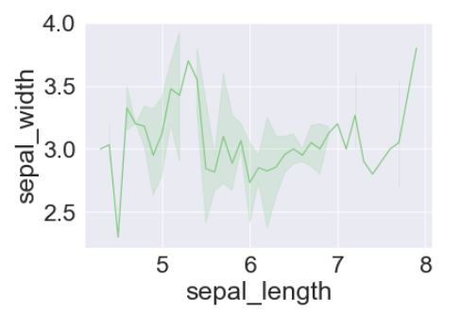
Setting the default Color Palette:[Accent]
# importing packages
import seaborn as sns
import matplotlib.pyplot as plt
# loading dataset
data = sns.load_dataset("iris")
sns.set_palette('Accent')
sns.lineplot(x="sepal_length", y="sepal_width", data=data)
01
08
Middle Level
Language
02
Memory
Management
Structured
Language
Speed
03
07
Rich Library
04
Pointers
Extensible
Recursion
05
Seaborn
UNIT-I
Department of CSE, School of Engineering, Malla Reddy University.

Slide 26
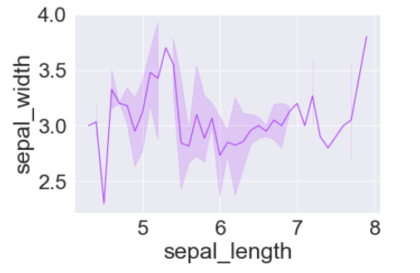
Setting another the default Color Palette:[gist_ncar_r]
# importing packages
import seaborn as sns
import matplotlib.pyplot as plt
# loading dataset
data = sns.load_dataset("iris")
sns.set_palette(' gist_ncar_r ')
sns.lineplot(x="sepal_length", y="sepal_width", data=data)
01
08
Middle Level
Language
02
Memory
Management
Structured
Language
Speed
03
07
Rich Library
04
Pointers
Extensible
Recursion
05
Seaborn
UNIT-I
Department of CSE, School of Engineering, Malla Reddy University.

Slide 27
Multiple plots with Seaborn:
Multiple plots can also be created using the Matplotlib as well as Seaborn.
Multiple plots created using Matplotlib:
Matplotlib provides various functions for plotting subplots. Some of them are
    1. add_axes(),
    2. subplot(), and
    3.subplot2grid()
Let’s see an example of each function for better understanding.
01
08
Middle Level
Language
02
Memory
Management
Structured
Language
Speed
03
07
Rich Library
04
Pointers
Extensible
Recursion
05
Seaborn
UNIT-I
Department of CSE, School of Engineering, Malla Reddy University.

Slide 28
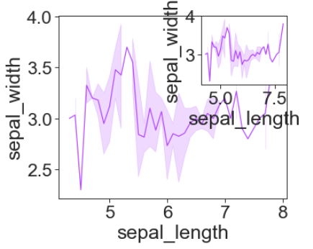
Example 1: Using add_axes() method
# importing packages
import seaborn as sns
import matplotlib.pyplot as plt
# loading dataset
data = sns.load_dataset("iris")
def graph():
sns.lineplot(x="sepal_length", y="sepal_width", data=data)
# Creating a new figure with width = 5 inches
# and height = 4 inches
fig = plt.figure(figsize =(5, 4))
# Creating first axes for the figure
ax1 = fig.add_axes([0.1, 0.1, 0.8, 0.8])
# plotting the graph
graph()
# Creating second axes for the figure
ax2 = fig.add_axes([0.5, 0.5, 0.3, 0.3])
# plotting the graph
graph()
plt.show()
01
08
Middle Level
Language
02
Memory
Management
Structured
Language
Speed
03
07
Rich Library
04
Pointers
Extensible
Recursion
05
Seaborn
UNIT-I
Department of CSE, School of Engineering, Malla Reddy University.

Slide 29
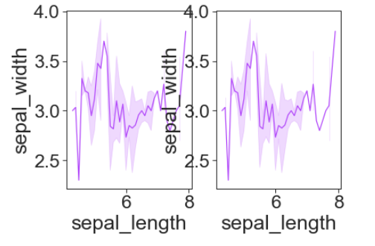
Example 1: Using subplot() method
(h = subplot(m,n,p) means m -by- n matrix of small axes, selects the p th axes object for for the current plot
# importing packages
import seaborn as sns
import matplotlib.pyplot as plt
# loading dataset
data = sns.load_dataset("iris")
def graph():
sns.lineplot(x="sepal_length", y="sepal_width", data=data)
# Adding the subplot at the specified
# grid position
plt.subplot(121)
graph()
# Adding the subplot at the specified
# grid position
plt.subplot(122)
graph()
plt.show()
01
08
Middle Level
Language
02
Memory
Management
Structured
Language
Speed
03
07
Rich Library
04
Pointers
Extensible
Recursion
05
Seaborn
UNIT-I
Department of CSE, School of Engineering, Malla Reddy University.

Slide 30
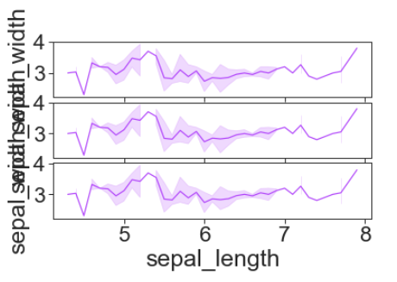
Example 1: Using subplot2grid() method
# importing packages
import seaborn as sns
import matplotlib.pyplot as plt
# loading dataset
data = sns.load_dataset("iris")
def graph():
sns.lineplot(x="sepal_length", y="sepal_width", data=data)
# adding the subplots
axes1 = plt.subplot2grid (
(7, 1), (0, 0), rowspan = 2, colspan = 1)
graph()
axes2 = plt.subplot2grid (
(7, 1), (2, 0), rowspan = 2, colspan = 1)
graph()
axes3 = plt.subplot2grid (
(7, 1), (4, 0), rowspan = 2, colspan = 1)
graph()
01
08
Middle Level
Language
02
Memory
Management
Structured
Language
Speed
03
07
Rich Library
04
Pointers
Extensible
Recursion
05
Seaborn
UNIT-I
Department of CSE, School of Engineering, Malla Reddy University.

Slide 31
Multiple plots created using Seaborn:
Seaborn also provides some functions for plotting multiple plots. Let’s see them in detail
Method 1:
Using FacetGrid() method:
FacetGrid class helps in visualizing distribution of one variable as well as the relationship between multiple variables separately within subsets of your dataset using multiple panels.
A FacetGrid can be drawn with up to three dimensions ? row, col, and hue. The first two have obvious correspondence with the resulting array of axes; think of the hue variable as a third dimension along a depth axis, where different levels are plotted with different colors.
FacetGrid object takes a dataframe as input and the names of the variables that will form the row, column, or hue dimensions of the grid.
01
08
Middle Level
Language
02
Memory
Management
Structured
Language
Speed
03
07
Rich Library
04
Pointers
Extensible
Recursion
05
Seaborn
UNIT-I
Department of CSE, School of Engineering, Malla Reddy University.

Slide 32
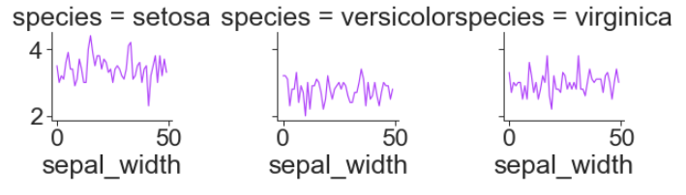
Example 1: Using FacetGrid() method
# importing packages
import seaborn as sns
import matplotlib.pyplot as plt
# loading dataset
data = sns.load_dataset("iris")
# Draw plots
plot = sns.FacetGrid(data, col="species")
plot.map(plt.plot, "sepal_width")
plt.show()
01
08
Middle Level
Language
02
Memory
Management
Structured
Language
Speed
03
07
Rich Library
04
Pointers
Extensible
Recursion
05
Seaborn
UNIT-I
Department of CSE, School of Engineering, Malla Reddy University.

Slide 33
Method 2: Using PairGrid() method
Subplot grid for plotting pairwise relationships in a dataset.
It maps each variable in a dataset onto a column and row in a grid of multiple axes. Different axes-level plotting functions can be used to draw bivariate plots in the upper and lower triangles, and the marginal distribution of each variable can be shown on the diagonal.
It can also represent an additional level of conventionalization with the hue parameter, which plots different subsets of data in different colors.
01
08
Middle Level
Language
02
Memory
Management
Structured
Language
Speed
03
07
Rich Library
04
Pointers
Extensible
Recursion
05
Seaborn
UNIT-I
Department of CSE, School of Engineering, Malla Reddy University.

Slide 34
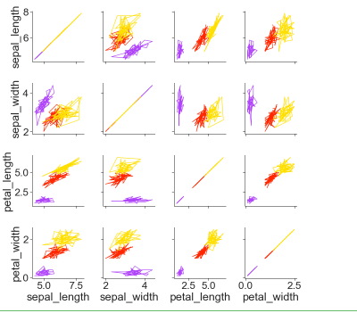
Example 1: Using PairGrid() method
# importing packages
import seaborn as sns
import matplotlib.pyplot as plt
# loading dataset
data = sns.load_dataset("iris")
# Draw plots
plot = sns.PairGrid(data, col="species")
plot.map(plt.plot, "sepal_width")
plt.show()
01
08
Middle Level
Language
02
Memory
Management
Structured
Language
Speed
03
07
Rich Library
04
Pointers
Extensible
Recursion
05
Seaborn
UNIT-I
Department of CSE, School of Engineering, Malla Reddy University.

Slide 35

www.mallareddyuniversity.com
Notes:
You can safely remove this slide. This slide design was provided by SlideModel.com – You can download more templates, shapes and elements for PowerPoint from http://slidemodel.com

